Slide 1
How does decarbonization affect water for energy systems?
Emily Grubert
Associate Professor, Keough School of Global Affairs
University of Notre Dame
16 March 2024, Alabama Water Rally 2024

Slide 2
The energy system is one of the US’ largest water users

Slide 3
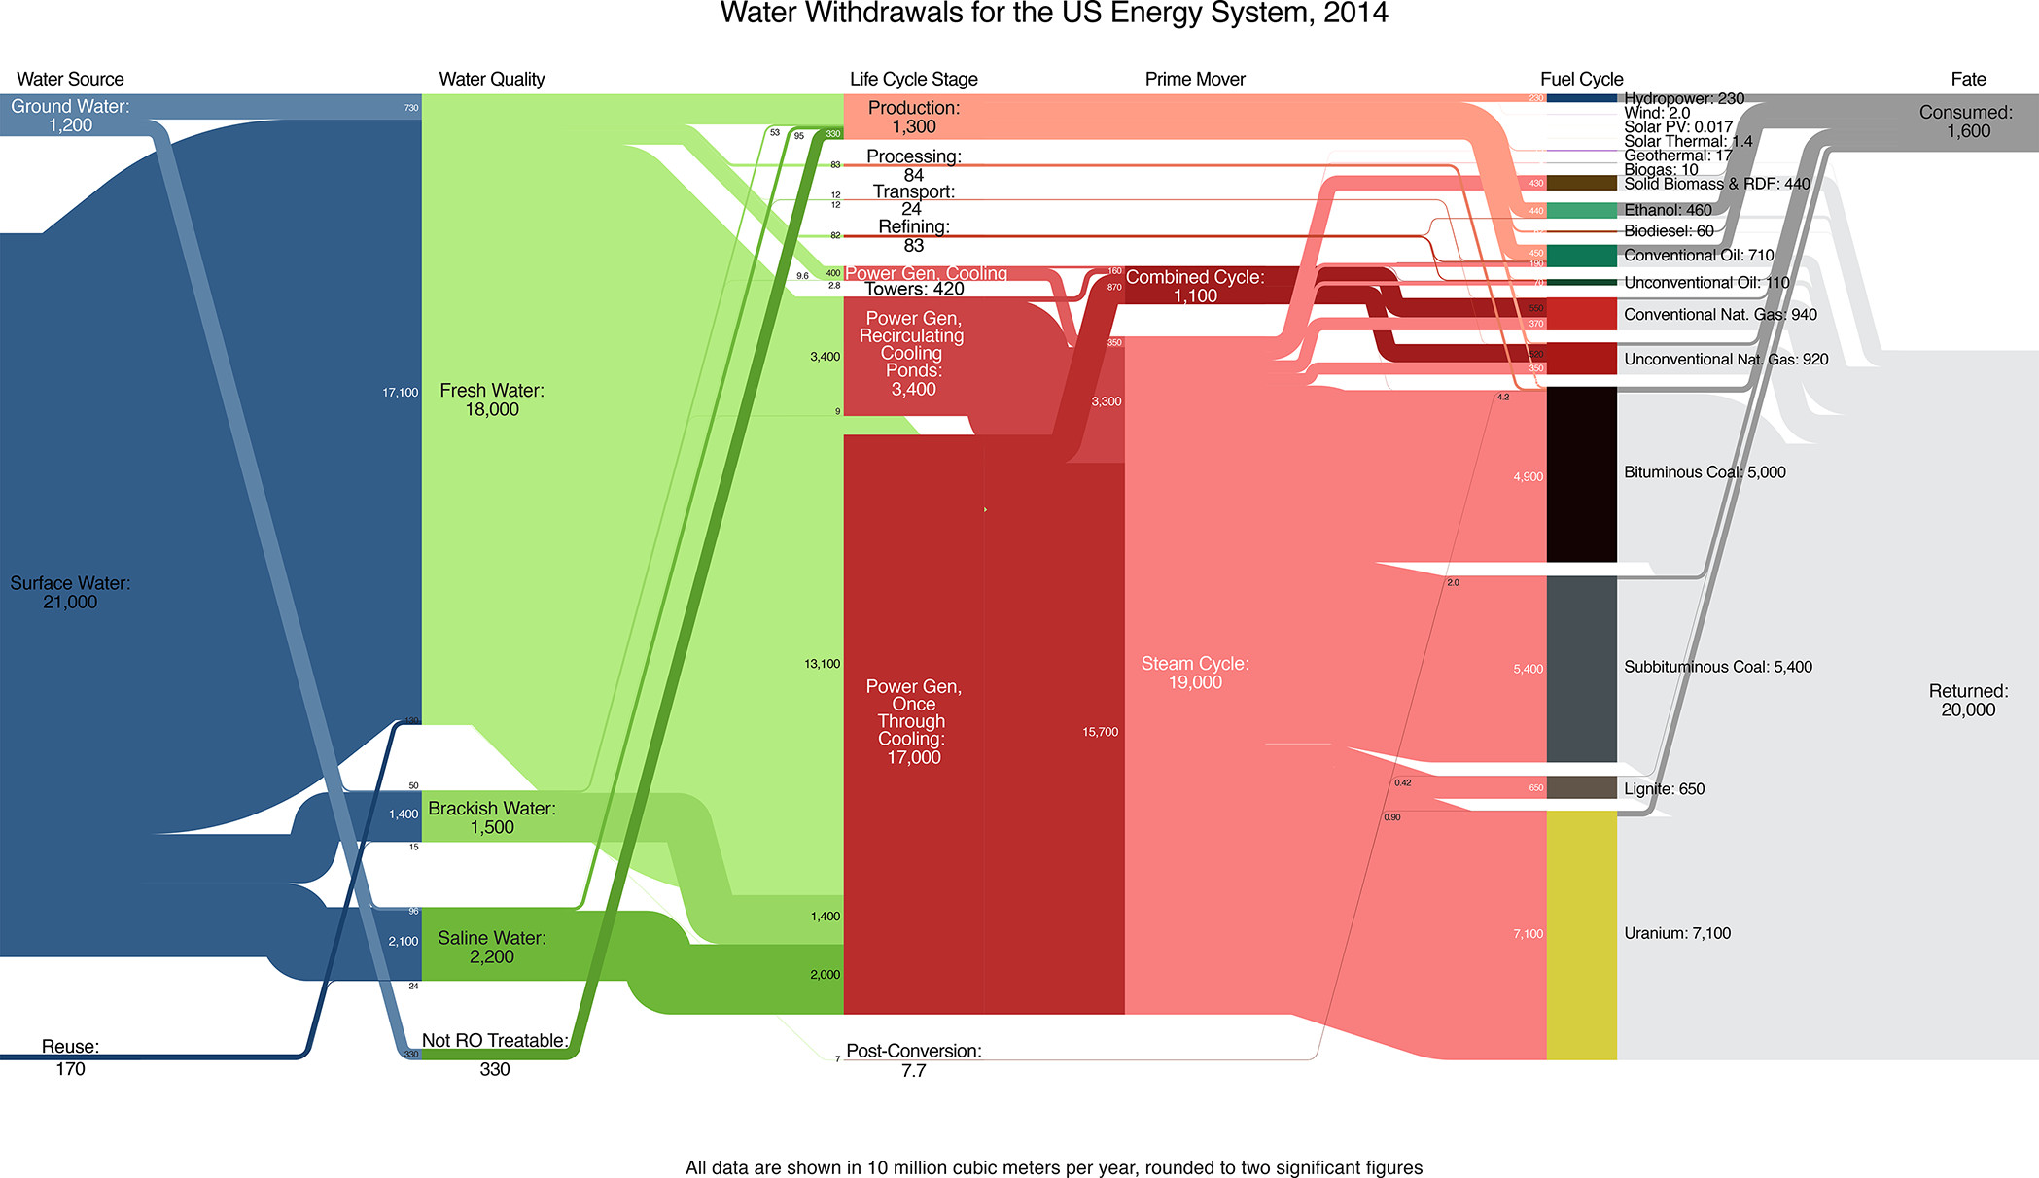
Grubert, Sanders 2018

Slide 4
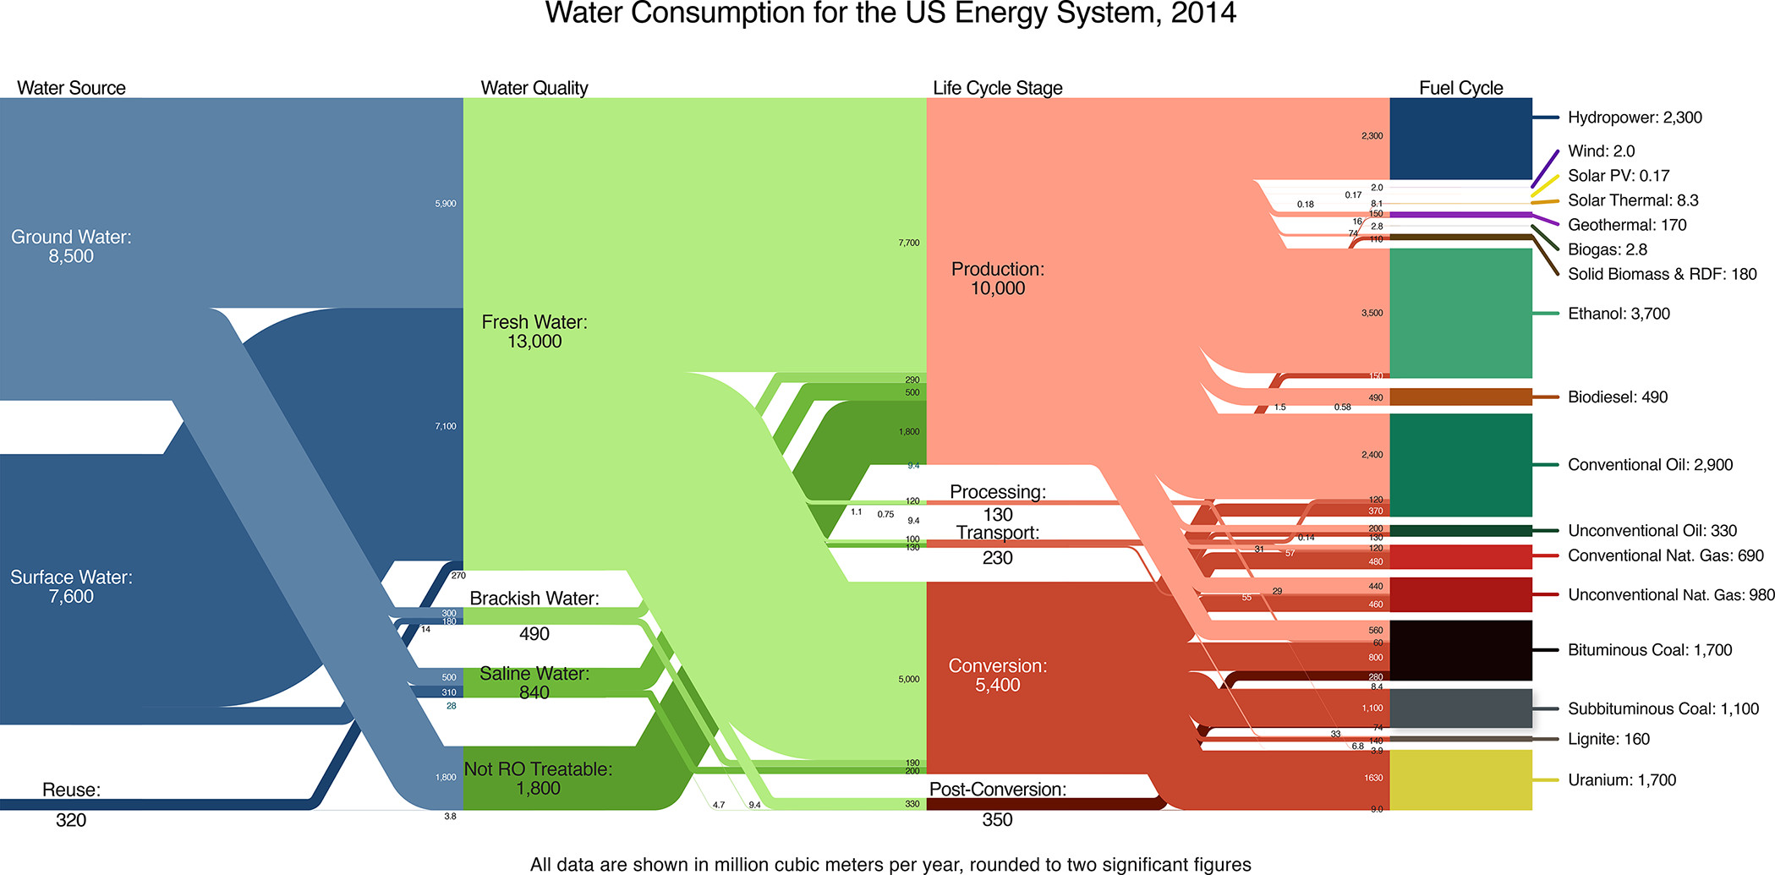
Grubert, Sanders 2018

Slide 5
Reaching (net) zero greenhouse gas emissions requires closing or dramatically remaking about 80% of the world’s energy system

Slide 6
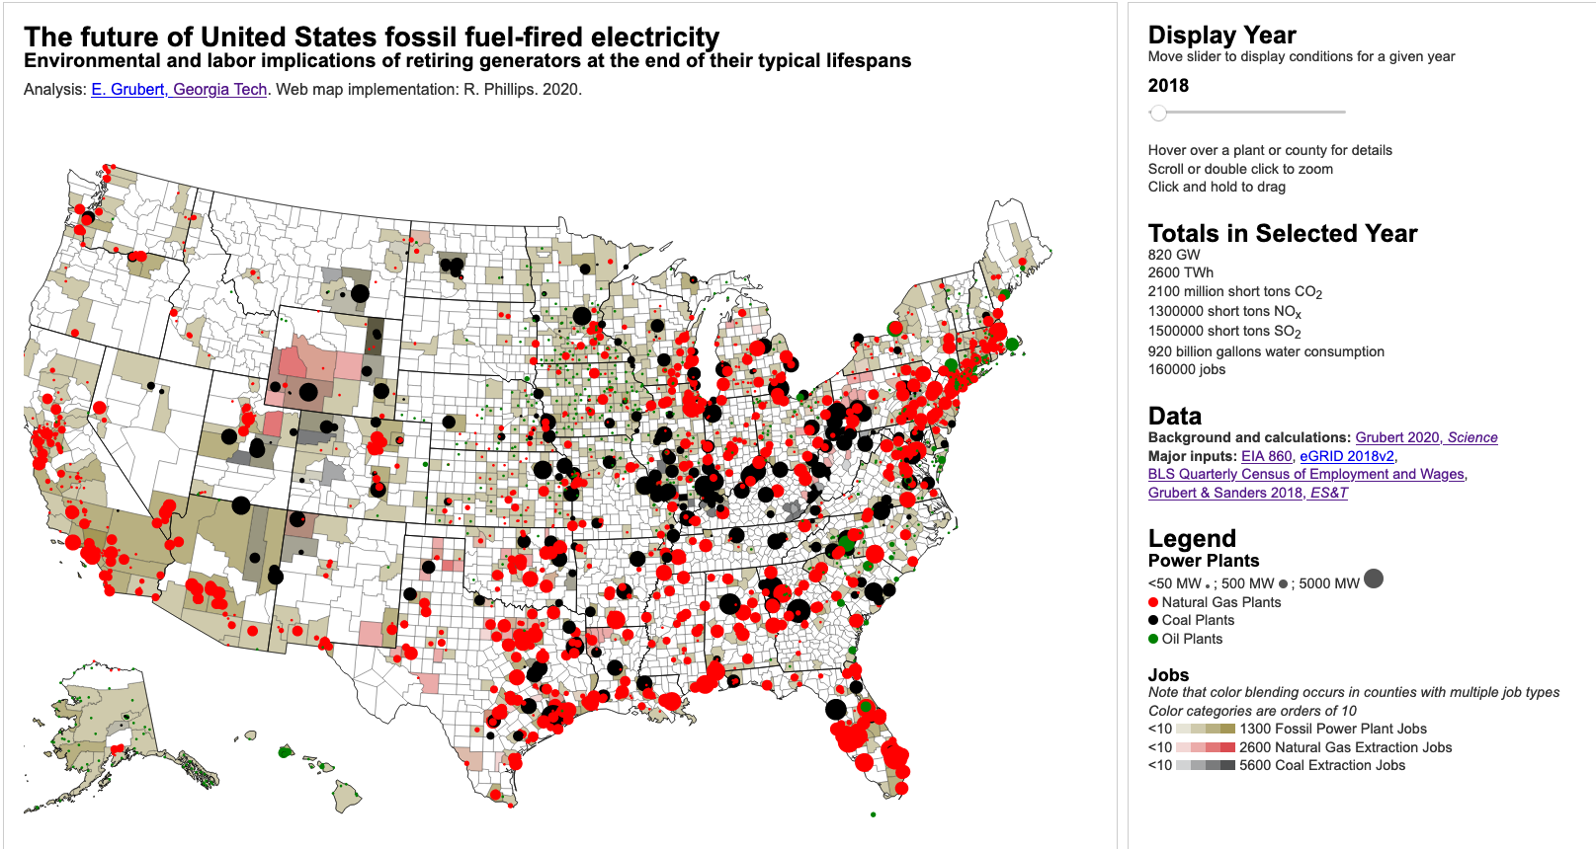
Emilygrubert.org/energy-transition
Interactive map: emilygrubert.org/energy-transition

Slide 7
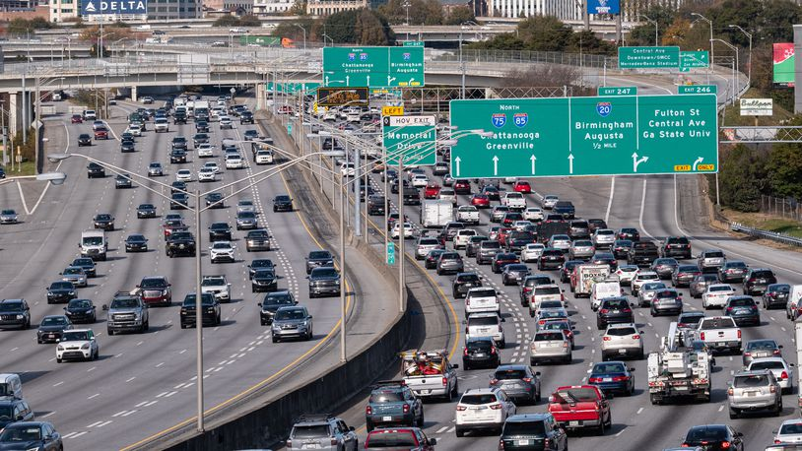
Source: Ben Gray (Atlanta, GA)
Notes:
Part of the reason that the electricity decarbonization target is earlier than the full economy target is that electricity is further along the decarbonization path
For transportation, which accounts for 27% of US energy consumption and now creates more greenhouse gas emissions than the electricity sector, we’re still about 90% dependent on oil, with a little bit of natural gas and some ethanol
Only 3% of transportation energy needs are met by other resources – which includes electricity
Hitting a 2050 decarbonization target means basically entirely overhauling the transportation sector – which is why it’s so important that states are starting to realize that oil vehicle sales will need to be phased out.
How many of you have driven cars older than 10 years? (pause)
Even my electric car is almost 10 years old – so you can see why it might be a problem if we’re still selling new cars that depend on oil by 2040, or even 2030
Some of these issues are harder for other forms of transportation, like air travel – but there are fewer individual actors involved
This transition will be a major overhaul, which again means we have some incredible opportunities to think about what we want these systems to look like. More trains? More public transit? Denser cities?

Slide 8
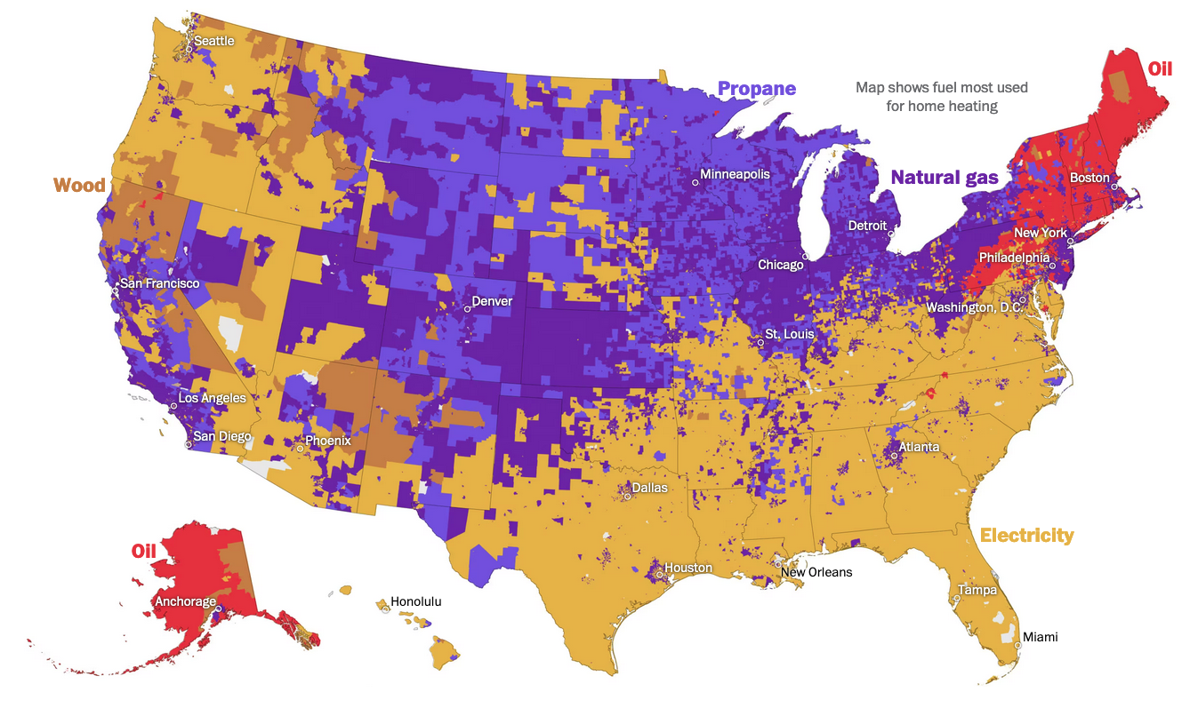
Source: Muyskens, Osaka, and Ahmed, 2023. U.S. home heating is fractured in surprising ways: Look up your neighborhood. The Washington Post. https://www.washingtonpost.com/climate-environment/interactive/2023/home-electrification-heat-pumps-gas-furnace/?itid=sf_climate_climate-lab_article_list
Notes:
Home heating is another really big way we use fossil fuels, and it’s especially important to the transition for a couple of reasons
Especially in cold places, not having heat means people can die
And, heating demands can be enormous – you might notice on this map of primary home heating fuel that the purples and reds – fossil fuels -- are common in cold places. That’s because the amount of energy it takes to heat from very cold conditions is extremely large, so it’s historically been much more cost effective to use fossil fuels directly rather than electricity that’s mostly fossil fuel derived, which involves a lot of losses
Under decarbonization, we expect most home heating will electrify. The good news is modern technologies like heat pumps are much more efficient than the more common resistance heating – think about it like you’re using a toaster to heat the home – but the demand is still huge. Heat pumps do both heating and air conditioning, and air conditioning demand already basically determines how big the grid is. Heating, even with efficient devices, can use way more energy because of the much bigger temperature differences – you might be heating from 10 degrees to 60 degrees, versus cooling from 100 degrees to 70 degrees
That means home heating is likely to be a major driver of how big the electricity grid needs to be, and it’s also a huge safety consideration and a transition process that happens inside people’s homes, so we need to get it right

Slide 9
We expect decarbonization will also mean dewatering...

Slide 10
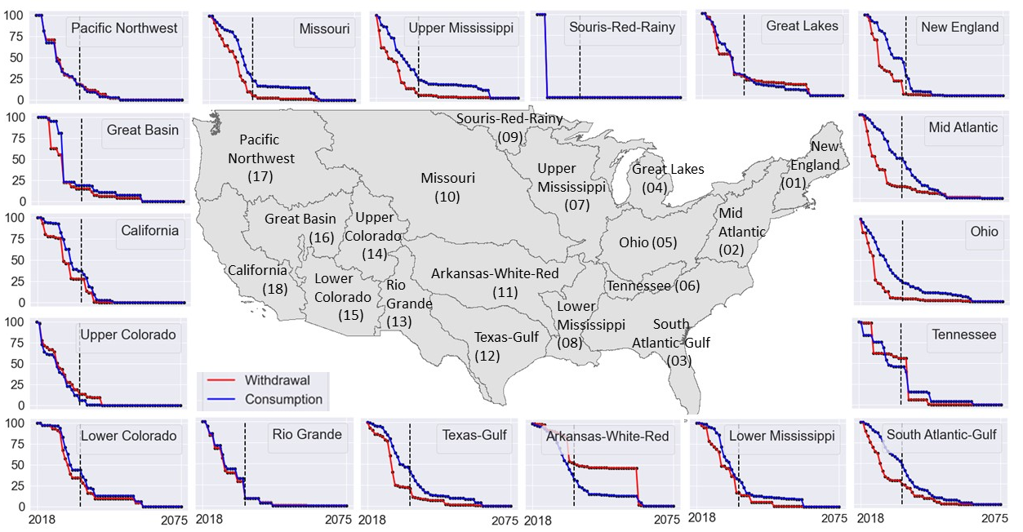
Siddik et al. 2023

Slide 11
2014 system
13 bcm freshwater consumption
Grubert, Marshall 2021

Slide 12
...but new water users (electrolysis, DAC, synfuels, mining, manufacturing) could bring substantial new pressures

Slide 13
Grubert 2023

Slide 14
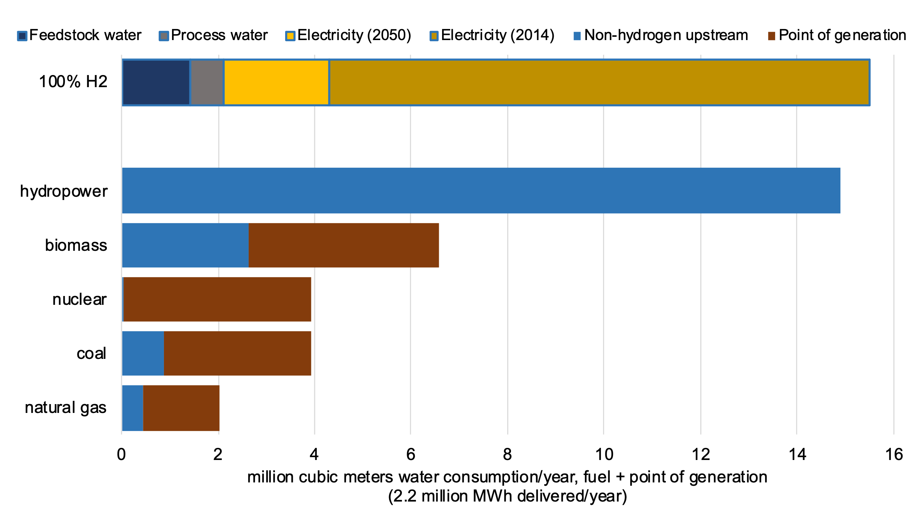
Grubert 2023

Slide 15
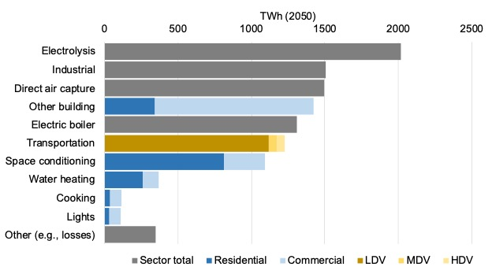
Grubert, Talati 2023

Slide 16
Transitioning legacy resources will affect the water system

Slide 17
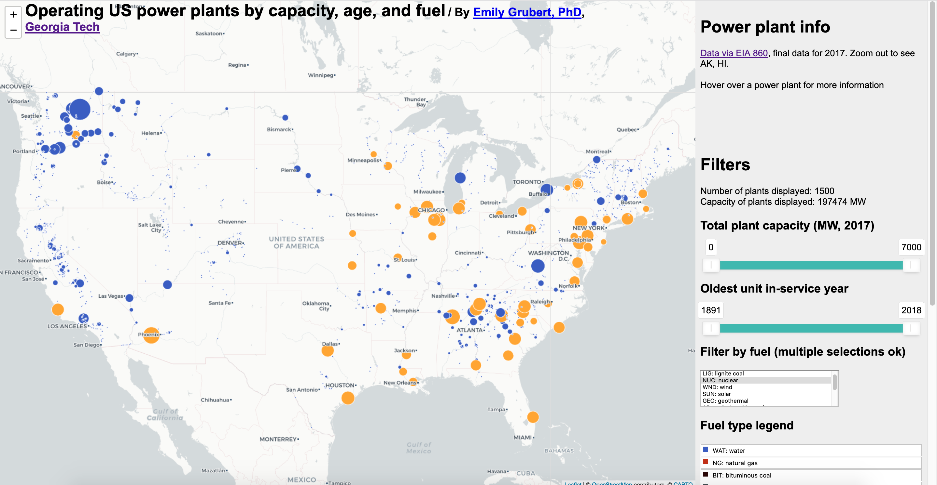
Hydroelectricity (and nuclear) will likely be asked to perform in ways they were not designed for
95% of installed hydro and nuclear capacity is at plants with at least one unit older than 30 years

Slide 18
Hydropower facilities are usually not just for hydropower
Grubert 2020

Slide 19
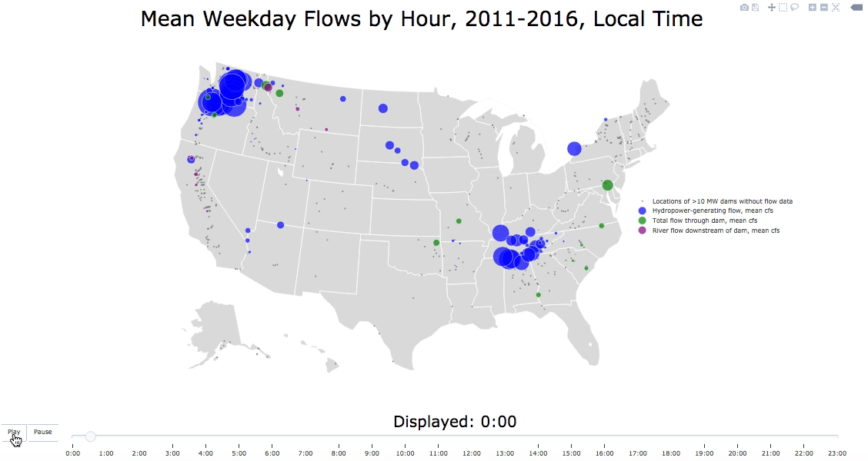

Slide 20
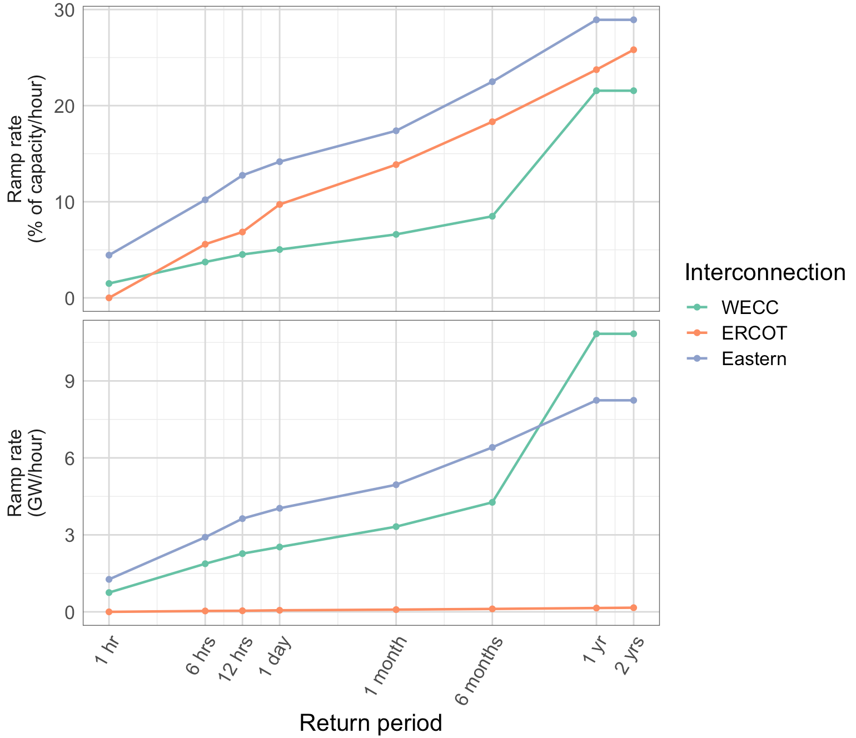
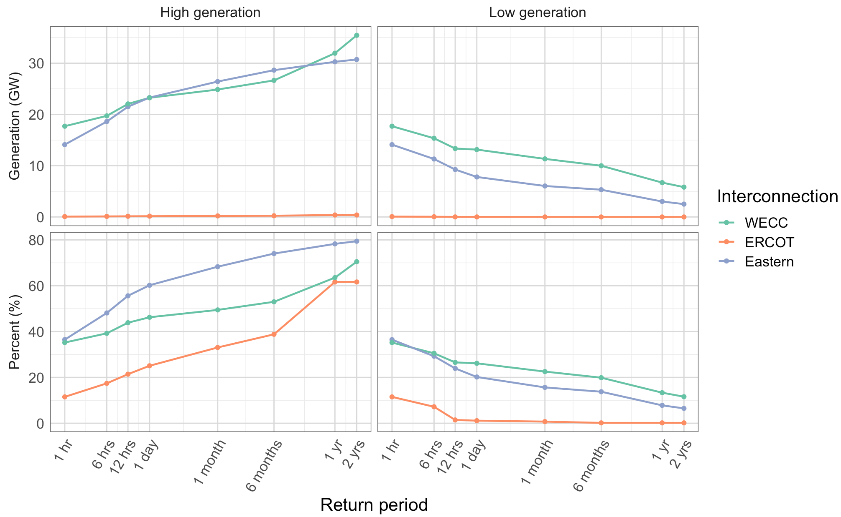
Hydropower is constrained, but somewhat flexible: but with safety and ecological implications
Marshall and Grubert 2022

Slide 21
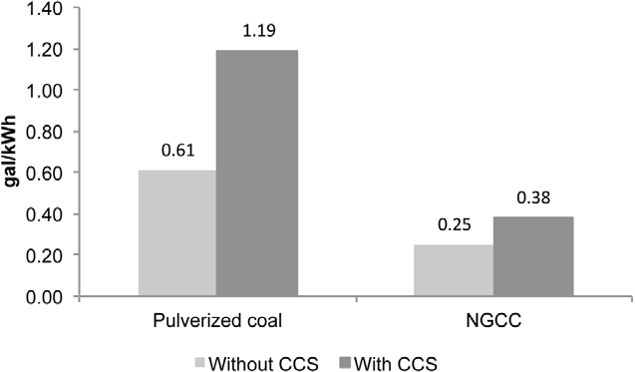
CCS significantly increases water requirements
Grubert et al. 2012

Slide 22

Decarbonization will have substantial impacts on the water system, with the potential to reduce or increase dependence
Emily Grubert
Associate Professor, Sustainable Energy Policy
Civil & Environmental Engineering & Earth Sciences (concurrent)
University of Notre Dame
egrubert@nd.edu
574.631.5911
@gruberte.bsky.social
Photo: Grubert

